Slide 1
Section 11.4 The Comparison Tests
Lecture 2
Limit Comparison Test

Slide 2
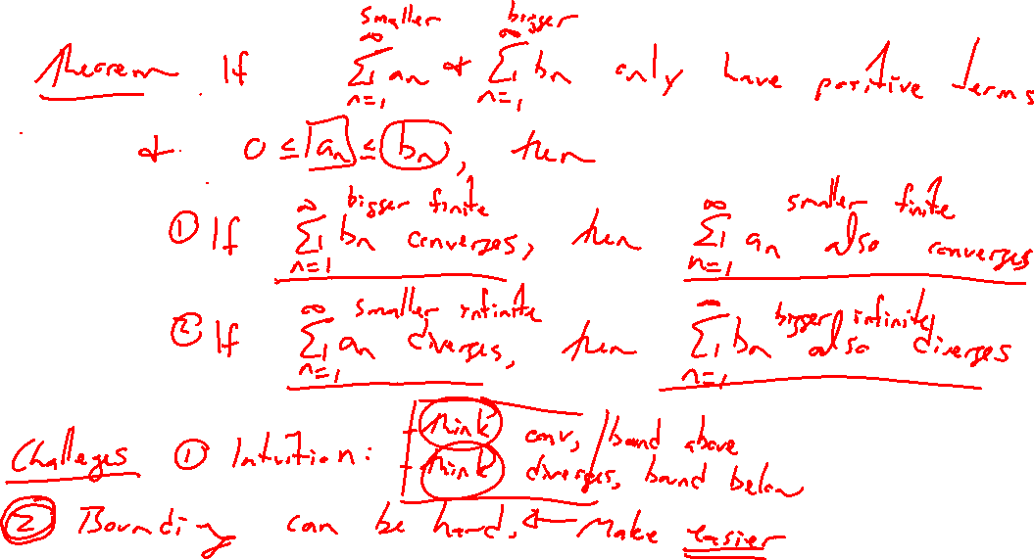
Reminder: Direct Comparison Test
Notes:
Main difficulty is
- need intuition
- bounding can be hard

Slide 3
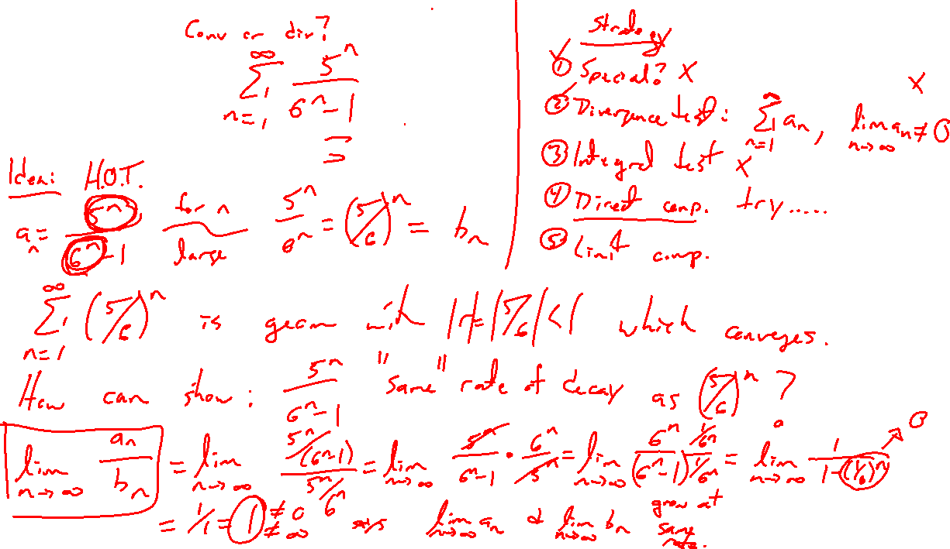
Example:
Notes:
5^n/(6^n-1), bounding is hard...show how at end
In limit should be have as (5/6)^n which is a convergent geom series
If they match, lim a_n/b_n = const = c > 0
So both decay at same rate and conv / div together

Slide 4
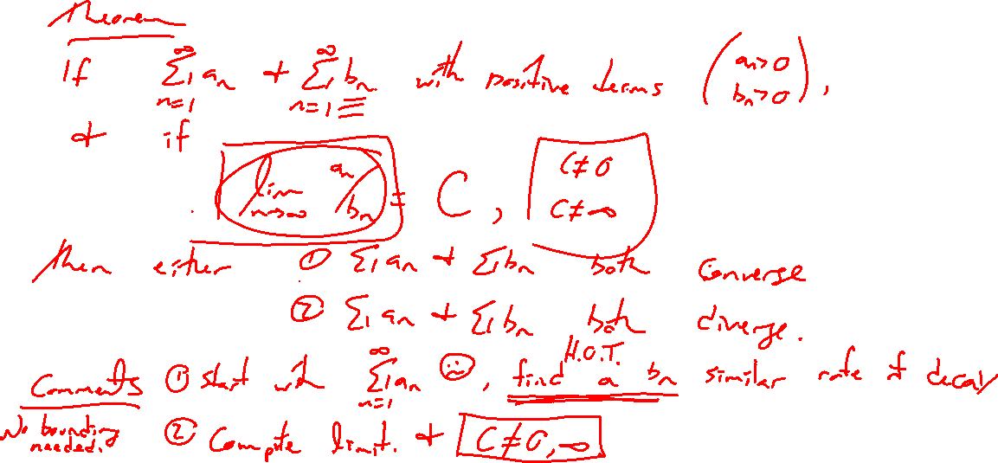
Limit Comparison Test
Notes:
Need a_n >0 , b_n>0 and lim a_n/b_n = c > 0 constant
Short and sweet proof in text

Slide 5
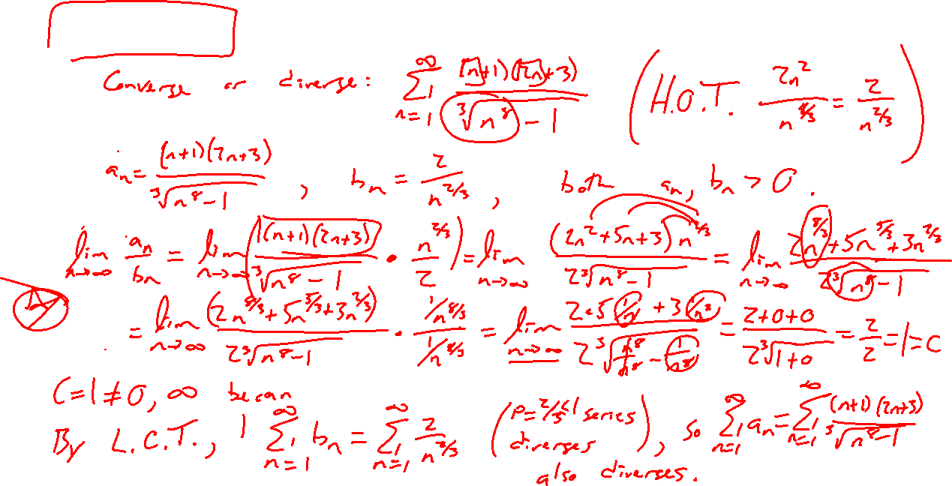
Example: Try on Own
Notes:
(k+1)(2k-3)/(k^8-1)^1/3
Go thru options (not special, div test fails, don’t want to integrate, direct compare messy)
Do limit compare to k^3/k^5 = 1/k^2
Note: what if c=0, c=\infty. Show the test is inconclusive

Slide 6
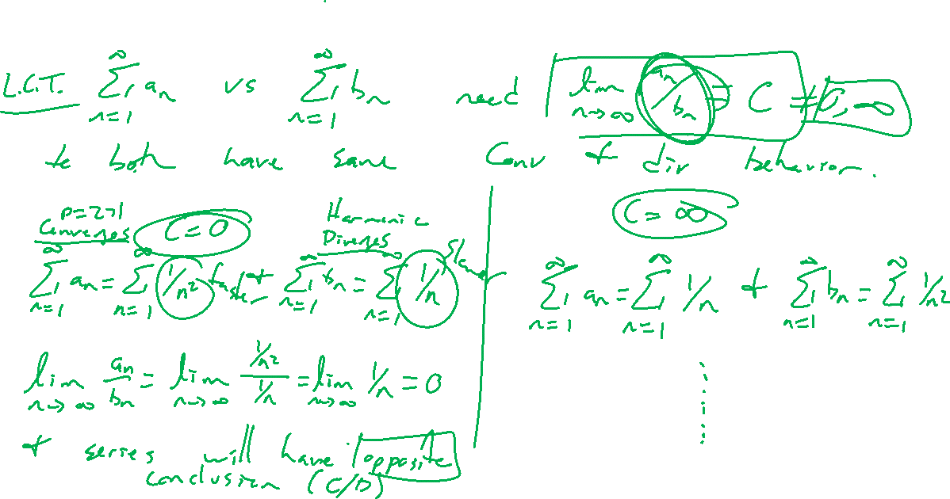
Limit Comparison Test Pitfalls
Notes:
Note: what if c=0, c=\infty. Show the test is inconclusive (both can conv, both can div, one of each).

Slide 7
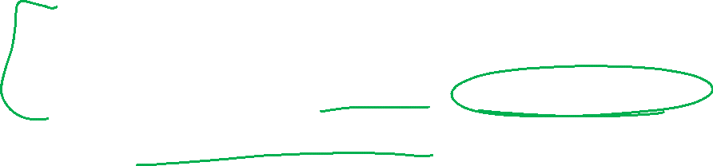
Section 11.4 Examples and Homework
Rework textbook examples: 1, 3, 4
Write down problem.
Close book and attempt on own.
Compare your solution to text solution, improve your writing.
Exercises: 3, 5, 7, 11, 19, 23, 25

Slide 8

Section Homework Submission to Canvas
Preview of section​
Skim section, write short paragraph summary, list all important definitions / theorems / formulas.​
Notes on video lectures​
Include all details, worked examples, your own thoughts​
Worked examples from text​
Solutions to exercises​
Final reflection of section​
List of key takeaways to remember​

